Slide 1


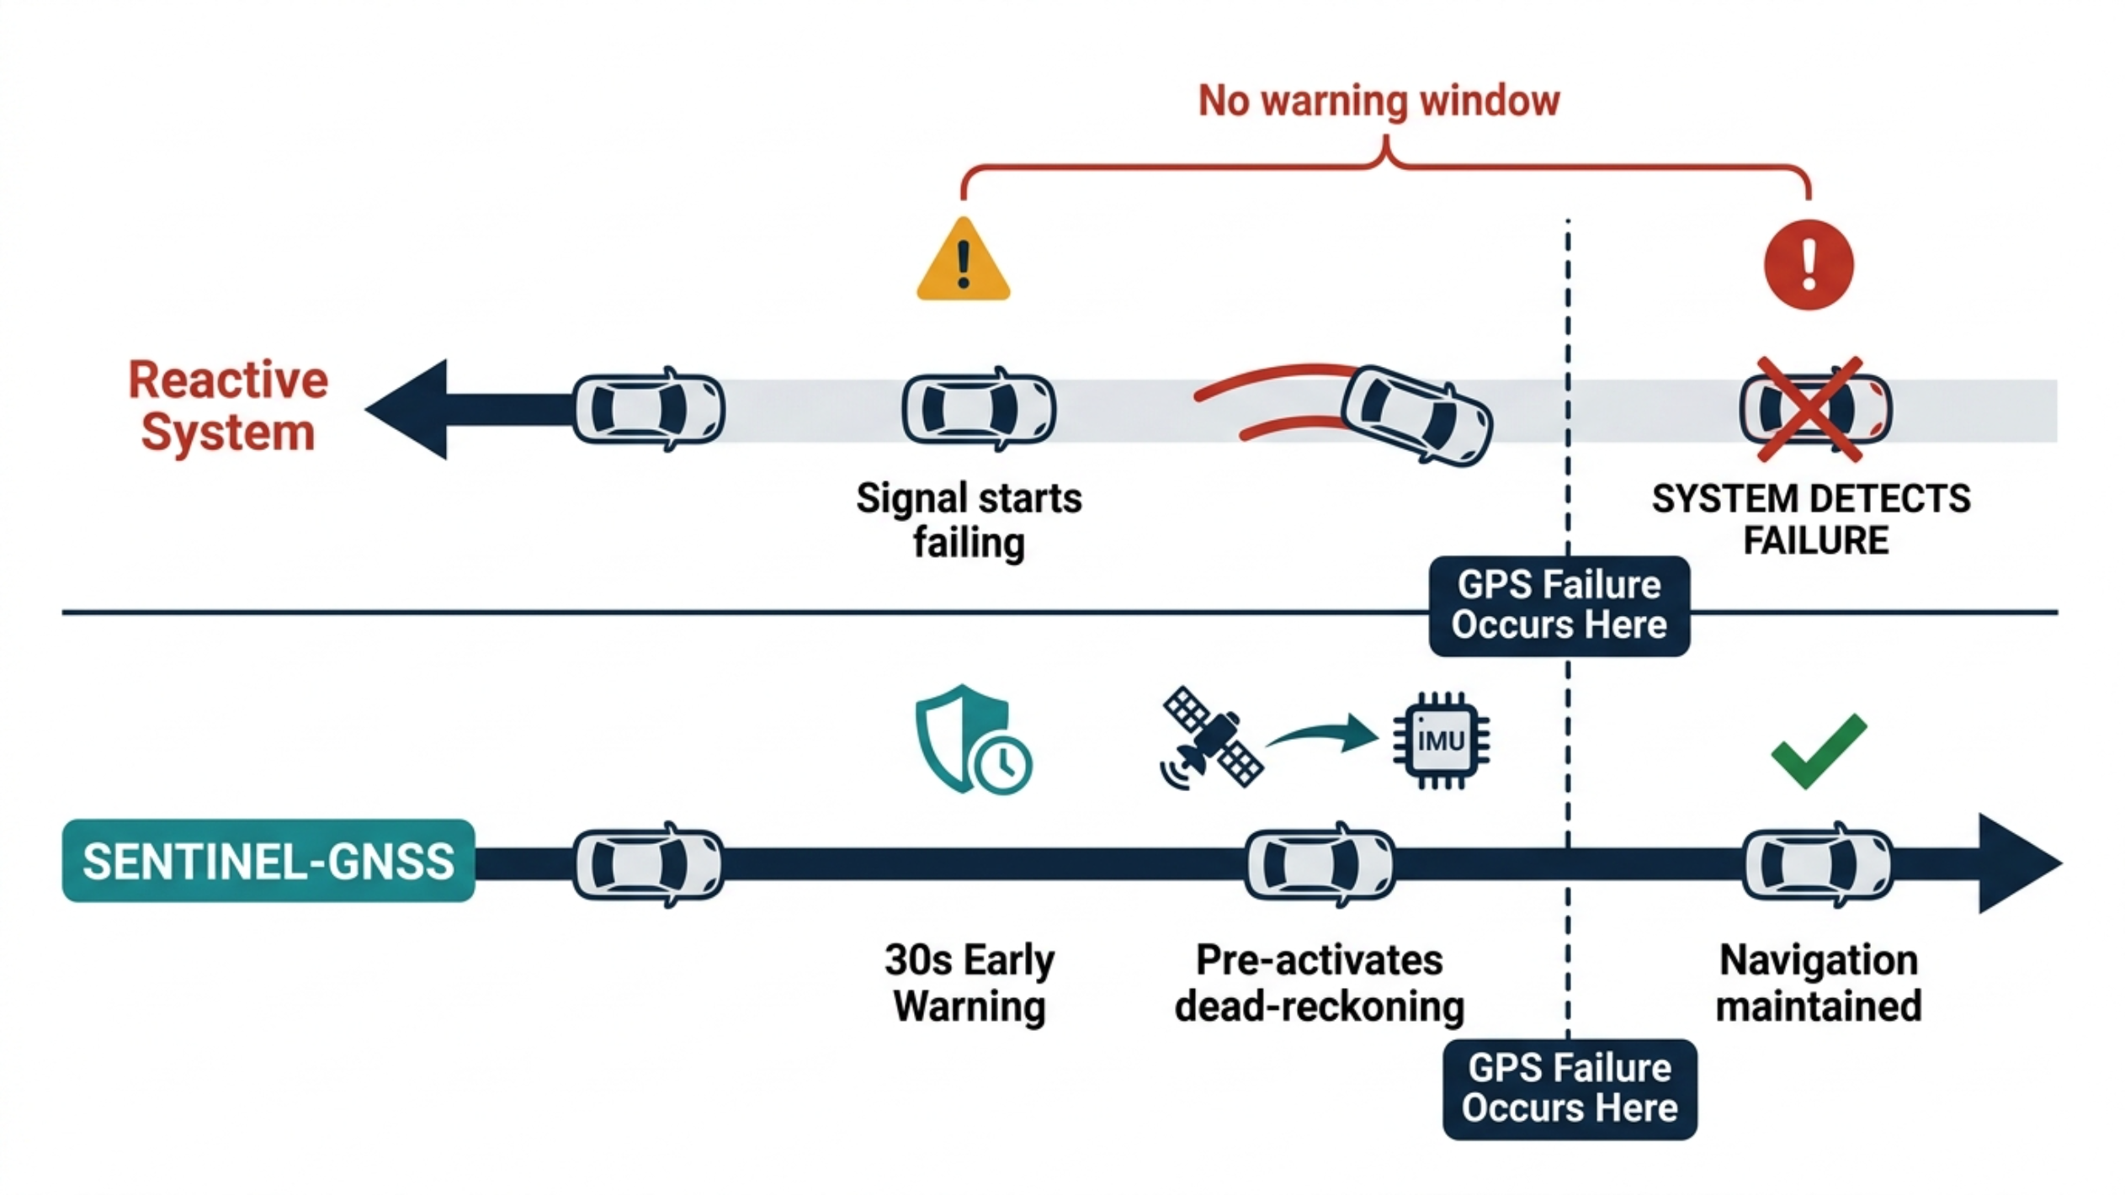
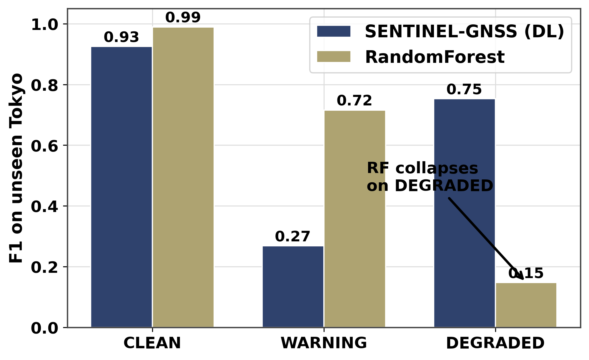
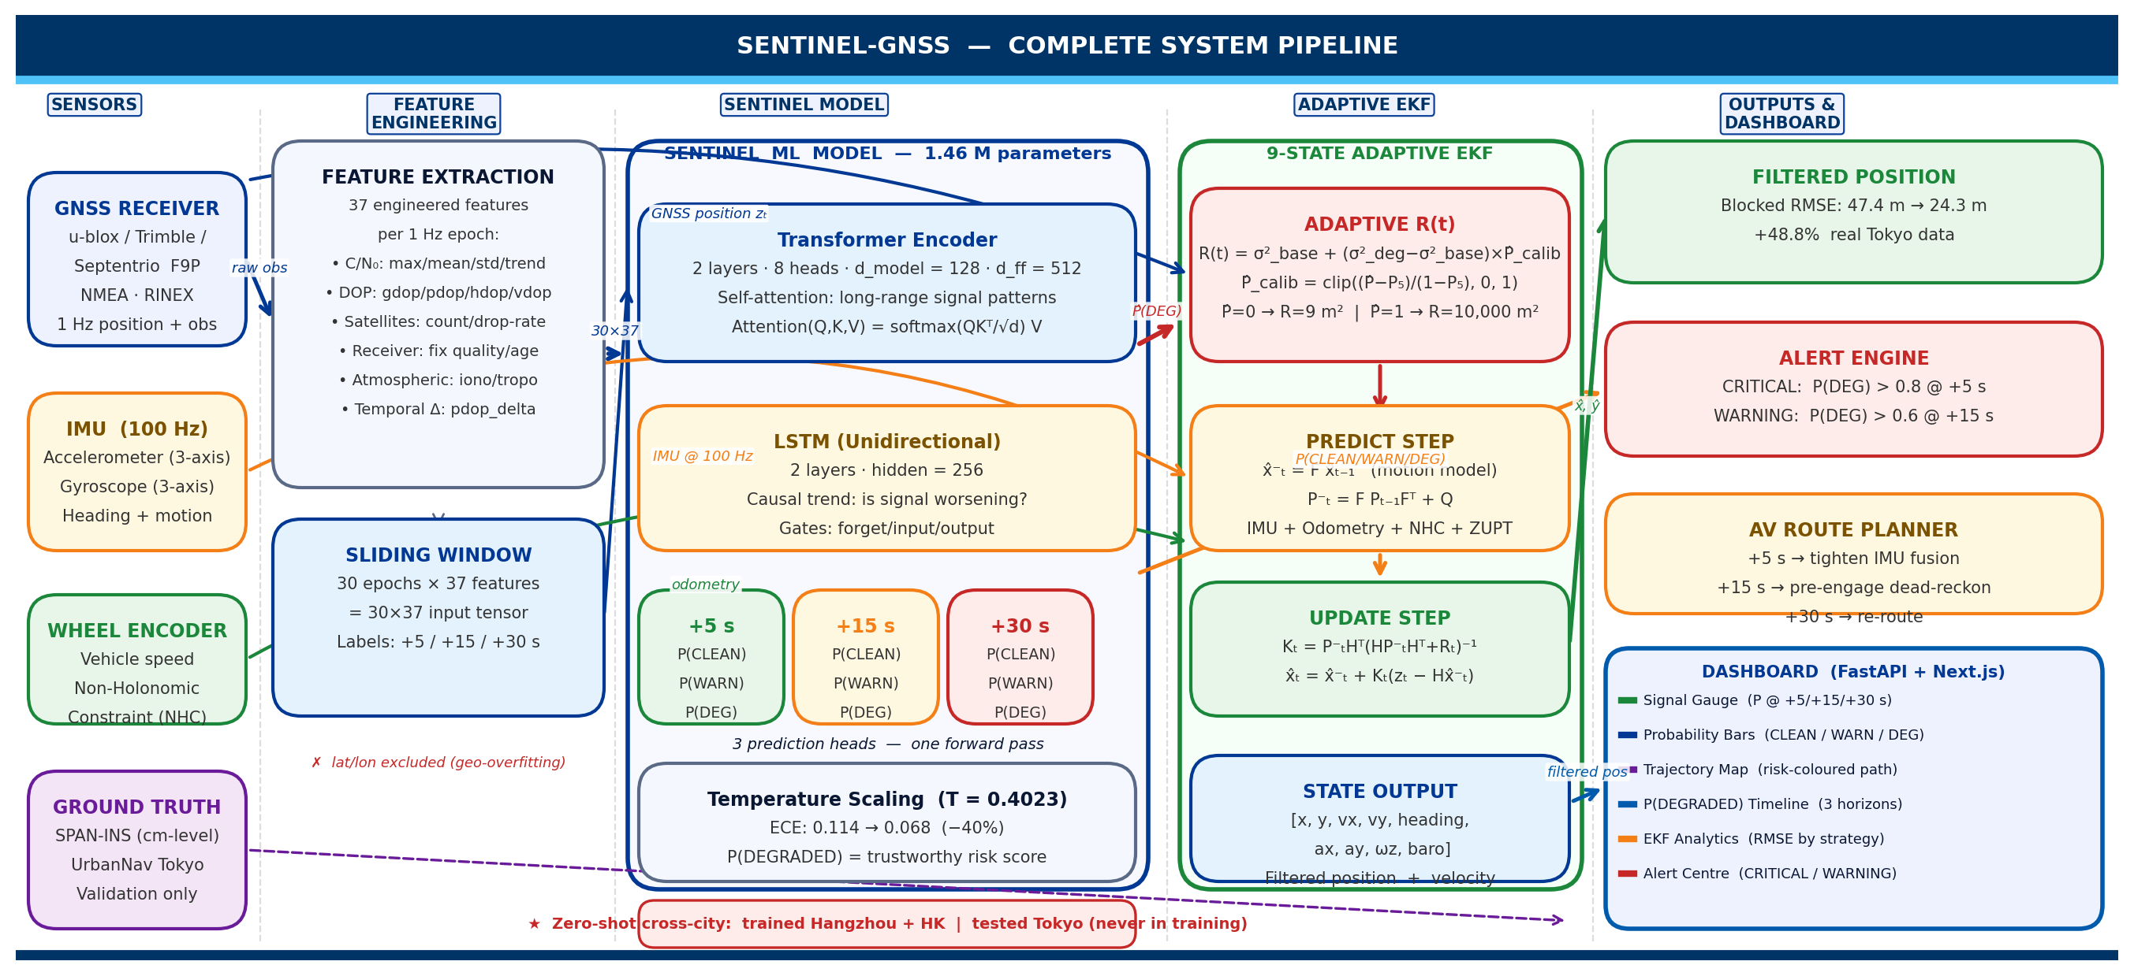
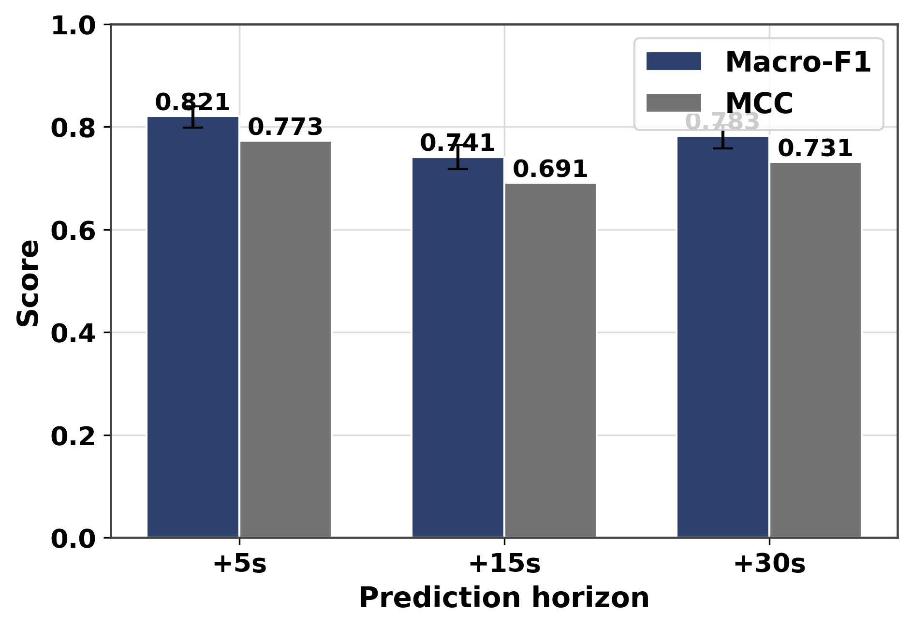
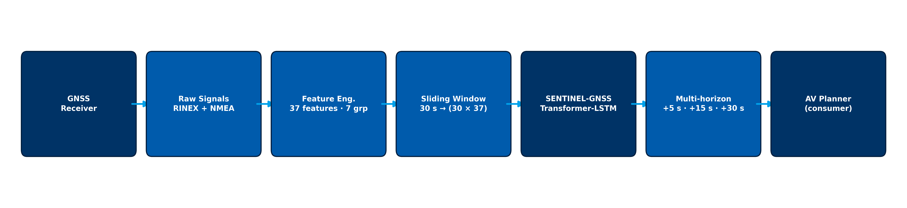
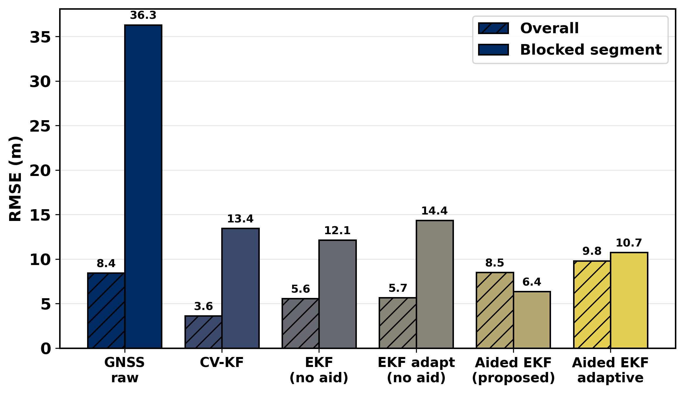
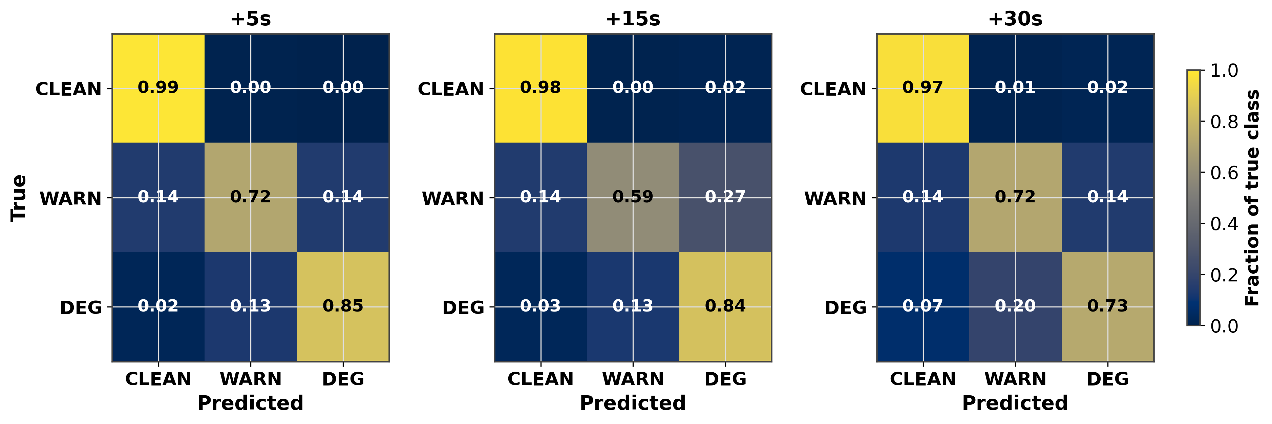
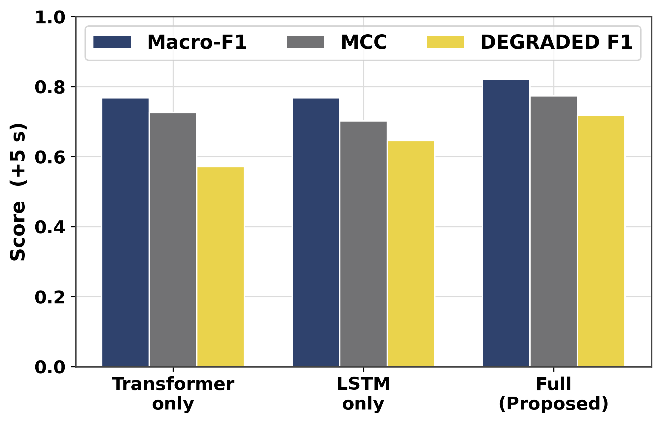
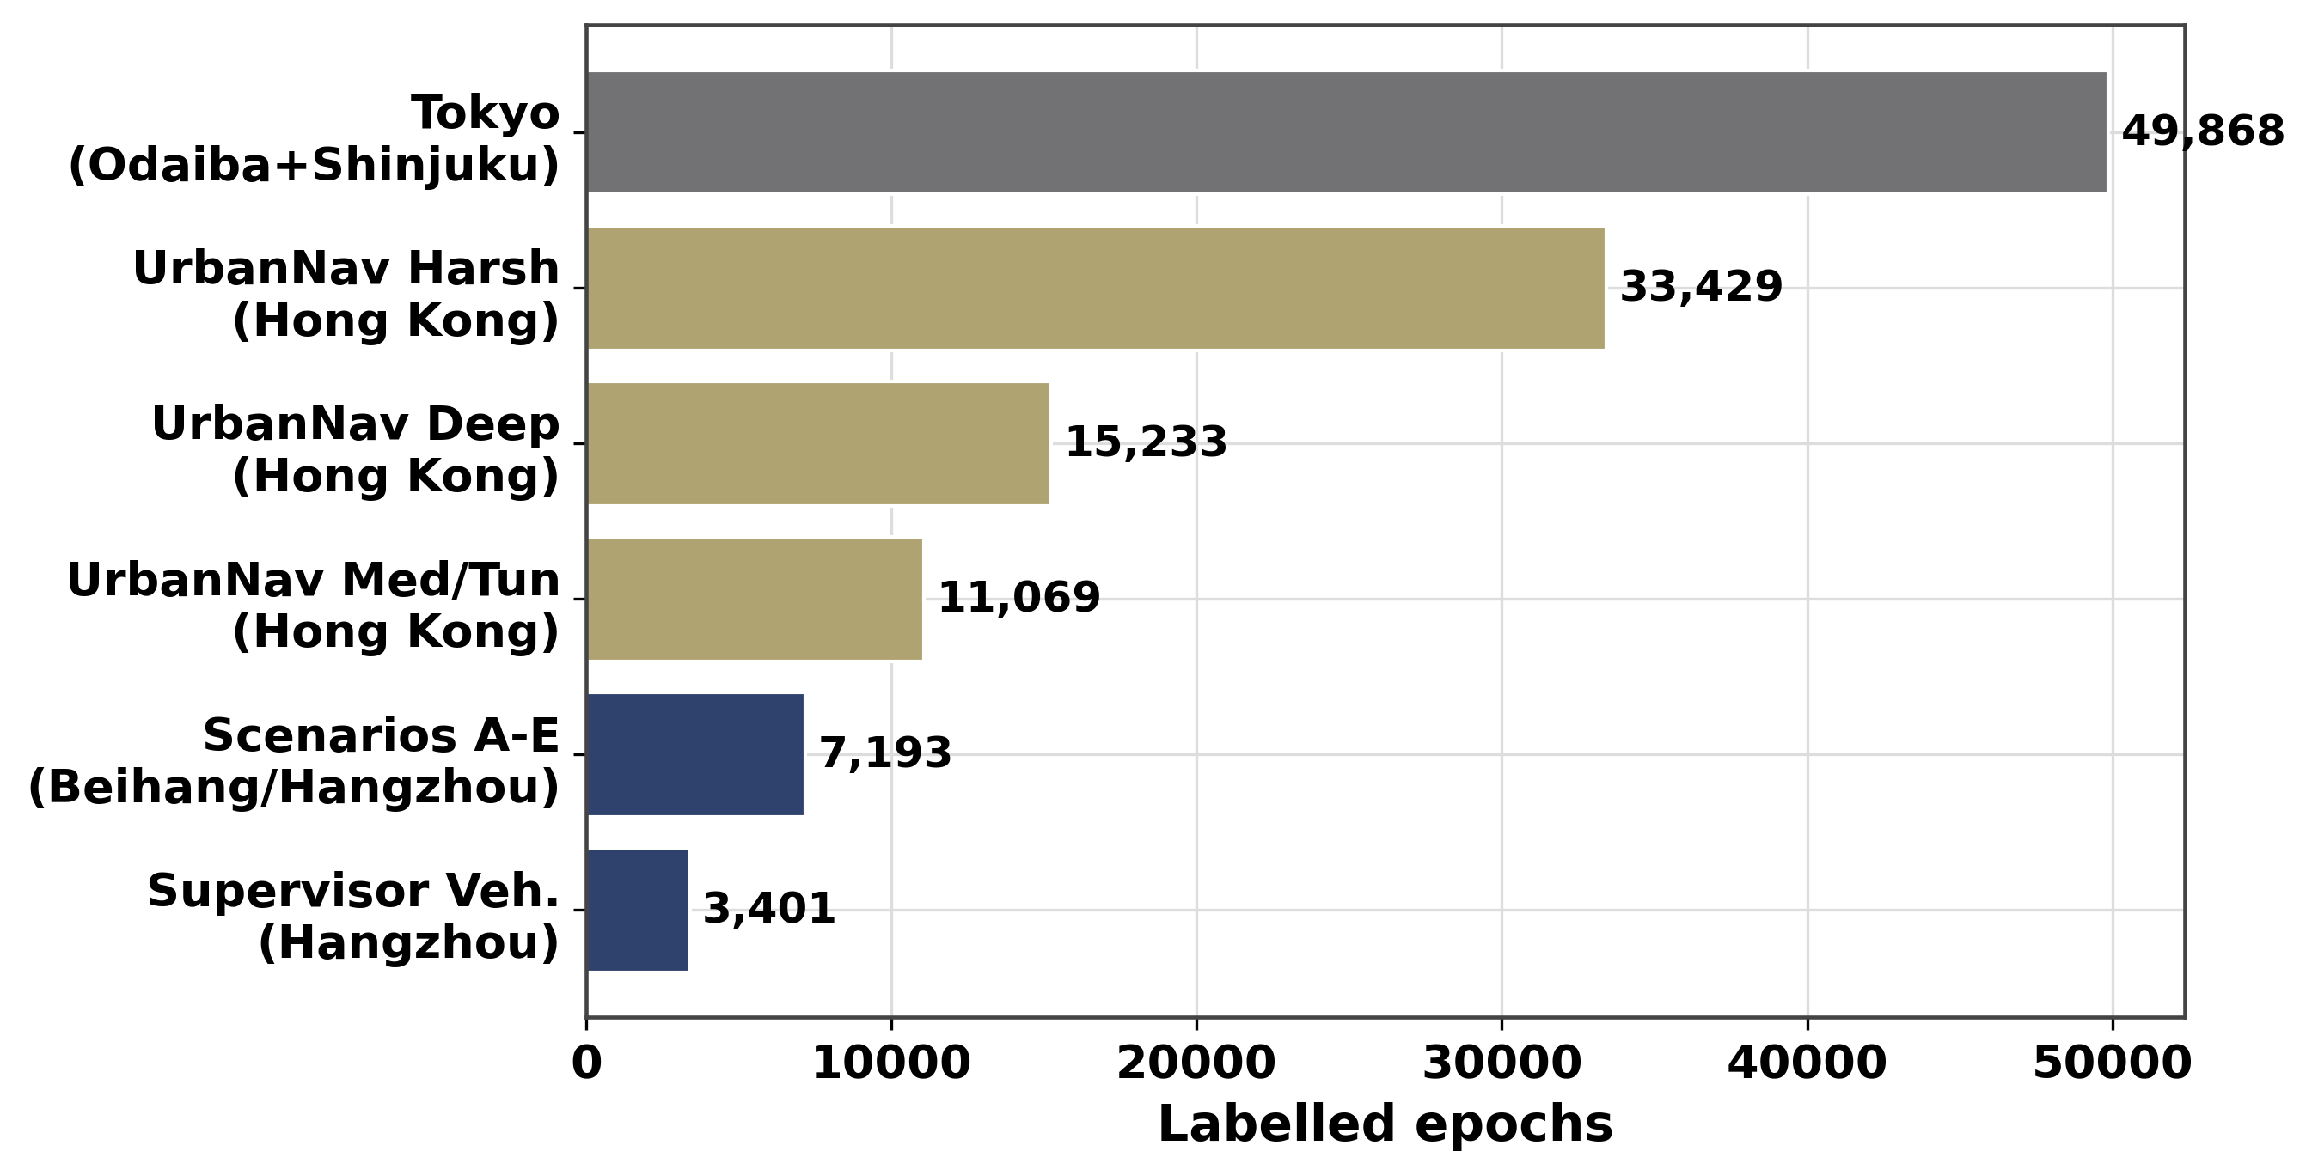
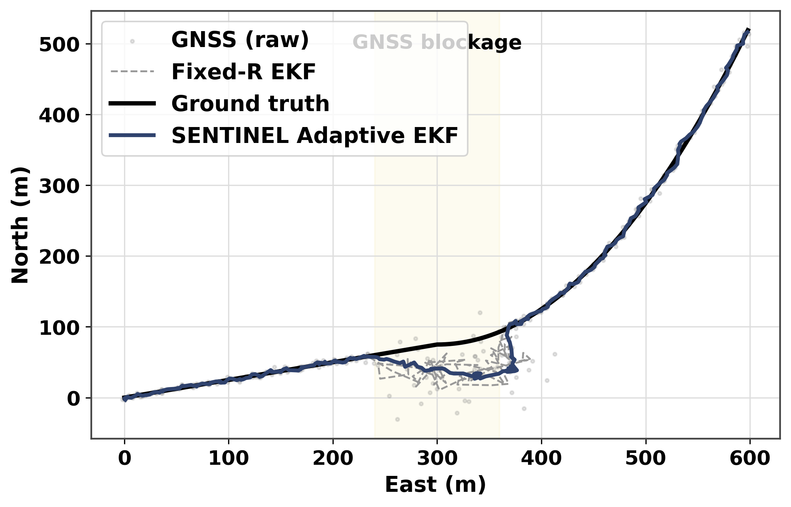
AI-Based Proactive Prediction Of GNSS Signal Degradation For Autonomous Vehicle Navigation
AI-Based Proactive Prediction Of GNSS Signal Degradation for Autonomous Vehicle Navigation
Ojerinde Joel Segun, Mustapha Ibrahim Ishola, Ogunlade Joshua Oluwaseun, Ingeriyinkindi Claudine, Rashid Md Harun Or
Regional Centre for Space Science and Technology Education in Asia and the Pacific | Beihang University
Introduction
System Architecture & Pipeline
Cross-city zero-shot: SENTINEL holds DEGRADED F1 = 0.75 on unseen Tokyo while Random Forest collapses to 0.15
GNSS is the only drift-free absolute position source for autonomous vehicles. At 60 km/h, a 5-second positioning gap can place the vehicle in the wrong lane or miss a junction. In urban areas GNSS fails silently: NLOS multipath injects 10 to 200 m errors while the receiver still reports a 'valid' fix. Existing monitors (RAIM, Q-codes, ML classifiers) are reactive, acting only after degradation begins. SENTINEL-GNSS instead predicts degradation 5 to 30 s in advance, giving the controller time to pre-activate dead reckoning.
SENTINEL-GNSS is a hybrid Transformer-LSTM. The Transformer (2 layers, 8 heads, d_model=128) reads global patterns across the 30 s window, while the stacked LSTM (hidden=256) tracks the directional approach to blockage as C/N0 declines and residuals grow. Three heads forecast +5 / +15 / +30 s in one forward pass.
Inference & Deployment: 1.46 M parameters, 0.039 ms per sample, all three horizons in one pass, 10.5x faster than three tree models, within a 10 Hz vehicle-compute budget.
Fig. 7: Cross-city DEGRADED-class F1 at +5 s. SENTINEL 0.75 versus RF 0.15, a 5x generalisation gap that widens further at +15 s and +30 s.
Methodology
Fig. 4: End-to-end SENTINEL-GNSS pipeline, from raw GNSS signals to multi-horizon AV-planner inputs via the Transformer-LSTM.
A unified pipeline turns raw multi-city GNSS into 37 engineered features and multi-horizon degradation labels.
Multi-horizon classification (held-out test, n=1,686): strong +5 s performance that degrades gracefully with horizon.
Dataset: 149,662 labelled epochs across 4 cities and 9+ receiver types. Hangzhou (Beihang campus, Scenarios A to E, Septentrio Mosaic-X5C); Hong Kong (UrbanNav: Medium, Deep, Harsh, Tunnel); Tokyo held-out (Shinjuku Trimble, Shinjuku u-blox F9P, Odaiba).
Features: 37 features in 7 groups, position quality, signal strength, satellite geometry, pseudorange residuals, temporal patterns, atmospheric delays, and receiver status. The receiver_tier feature encodes hardware class so one model handles Septentrio (48 dB-Hz) and u-blox (38 dB-Hz) identically.
Model: a hybrid Transformer-LSTM. The Transformer (2 layers, 8 heads, d_model=128) reads global patterns across the 30 s window; a 2-layer LSTM (hidden=256) tracks the directional approach to blockage. Three heads predict +5, +15, and +30 s. 1.46 M parameters, 0.039 ms per sample.
Horizon | Macro-F1 | DEGRADED-F1 | MCC
+5 s | 0.821 | 0.718 | 0.773
+15 s | 0.741 | 0.583 | 0.691
+30 s | 0.783 | 0.629 | 0.731
Prediction-Informed EKF
Prediction inflates GPS noise R before bad epochs arrive (Joseph-form EKF):
Predict: xp = f(x, u); Pp = F P F^T + Q
Update: K = Pp H^T (H Pp H^T + R)^-1
x = xp + K (z - H xp)
P = (I - K H) Pp (I - K H)^T + K R K^T [Joseph form]
Adaptive: R = (40 m)^2 I2 if P(DEGRADED) > 0.45, else r_base^2 I2
Multi-horizon classification metrics. Held-out test (n=1,686); 95% CI via 1,000 bootstrap iterations. DEGRADED recall = 0.847 at +5 s.
Macro-F1 and MCC across prediction horizons with bootstrap 95% CI. Performance degrades gracefully as the horizon extends.
Method | Environment | RMSE red.
EKF Fixed-R + SENTINEL | Trimble Shinjuku | 48.8%
Huber EKF | u-blox Shinjuku | 25.2%
Student-t PF | Odaiba harbour | 40.1%
Classification performance across all horizons on the held-out test set.
Ablation: both the Transformer and the LSTM are necessary; receiver_tier is the most important feature.
Row-normalised confusion matrices (+5 s, +15 s, +30 s). CLEAN recall stays above 0.97 at all horizons; DEGRADED recall falls from 0.85 to 0.73 as the horizon extends.
Ablation across architecture variants (Macro-F1, MCC, DEGRADED-F1). Each component contributes independently to performance.
Dataset composition across four cities, with Tokyo strictly held out.
Prediction-informed EKF keeps the trajectory accurate through blockage.
Conclusions
*
Key results: to our knowledge, the first system to predict GNSS degradation 5 to 30 s ahead; Macro-F1 = 0.821 at +5 s (DEGRADED recall 0.847); cross-city DEGRADED F1 of 0.75 vs 0.15 for RF; 48.8% degraded-RMSE reduction via prediction-informed EKF; 0.039 ms inference.
Honest disclosure: RF and XGBoost beat SENTINEL in-domain (F1 0.926 vs 0.821), but cross-city generalisation is the deployment-relevant metric.
Key finding: no single fusion method dominates every environment, so environment-aware method selection is a productive direction.
Acknowledgments
Dataset composition. Tokyo (49,868 epochs) is strictly held out and never seen during training or validation.
SENTINEL trajectory (blue) hugs ground truth through blockage while the Fixed-R EKF and raw GNSS diverge.
We thank our supervisor Dr. Ahmed Wasiu and RCSSTEAP program at Beihang University for guidance, equipment, and field-collection support throughout the SENTINEL-GNSS pilot project.
Key references: Brown 1997 (RAIM) - Hsu 2021 (UrbanNav) - Liu 2023 (GBT GNSS) - Chen 2019 (LSTM GPS) - Vaswani 2017 (Transformer) - Hochreiter 1997 (LSTM) - Mehra 1970 (Adaptive Kalman) - Kalman 1960 (EKF).

